Slide 1


HLTINF006
Apply basic principles and practices of infection prevention and control (Release 1)

Slide 2

About this Unit of Competency
HLTINF006 - Apply basic principles and practices of infection prevention and control (Release 1)
This unit describes the performance outcomes, skills and knowledge required to apply basic infection prevention and control principles in a workplace, including implementing standard and transmission-based precautions and responding to risks.

Slide 3

This unit applies to individuals working in a range of industry and work setting contexts.
The skills in this unit must be applied in accordance with Commonwealth and State or Territory legislation, Australian standards and industry codes of practice.

Slide 4

Presentation Objectives
At the end of this session, you will be able to:
Identify the role of infection prevention and control in the work setting
Follow standard and transmission-based precautions for infection prevention and control in the work setting
Respond to potential and actual exposure to infection risks within scope of own role

Slide 5
Introduction
Infection prevention and control (IPC) is the method through which people can prevent infections from occurring.
Small actions like personal hygiene and hand washing can significantly impact this situation.
This presentation will go through how to apply infection prevention and control to your situation.
Infection prevention and control at work ensure that disease does not prohibit you from accomplishing your work and personal goals.

Slide 6

Identify the Role of Infection Prevention and Control in the Work Setting
HLTINF006 - Apply basic principles and practices of infection prevention and control (Release 1)

Slide 7

1.1 Identify Relevant Standards and Guidelines

Slide 8

Standards and guidelines are documents developed by industries to ensure the following:
Services, products and processes are at the minimum expected quality
The outcomes of your work reach the quality set by industry experts
Identify the Role of Infection Prevention and Control in the Work Setting

Slide 9
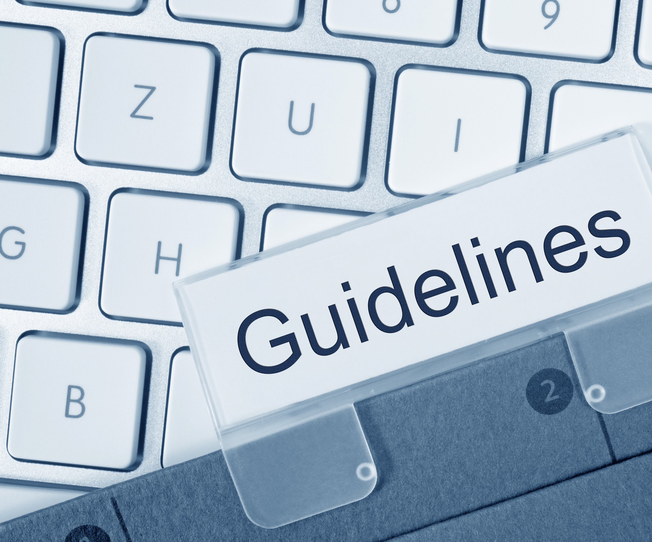
Standards and guidelines may vary based on your job role and setting.
Here are some examples of standards and guidelines:
The Australian Guidelines for the Prevention and Control of Infection in Healthcare
Preventing and Controlling Infections Standard of the National Safety and Quality Health Service (NSQHS) Standards
Identify the Role of Infection Prevention and Control in the Work Setting

Slide 10
The following are the basic principles that address them:
An understanding of the modes of transmission of infectious agents of risk management
Effective work practices minimise the risk of transmission of infectious agents
Governance structures that support the implementation, monitoring and reporting of infection prevention and control work practices
Compliance with legislation, regulations and standards relevant to infection control
Identify the Role of Infection Prevention and Control in the Work Setting

Slide 11

Preventing and Controlling Infections Standard of the National Safety and Quality Health Service (NSQHS) Standards
The ACSQHC developed the NSQHS standards to explain the conditions for providing quality health care.
Identify the Role of Infection Prevention and Control in the Work Setting

Slide 12
Below are the eight NSQHS standards:
Clinical governance
Partnering with consumers
Preventing and controlling infections
Medication safety
Comprehensive care
Communicating for safety
Blood management
Recognising and responding to acute deterioration
Identify the Role of Infection Prevention and Control in the Work Setting

Slide 13
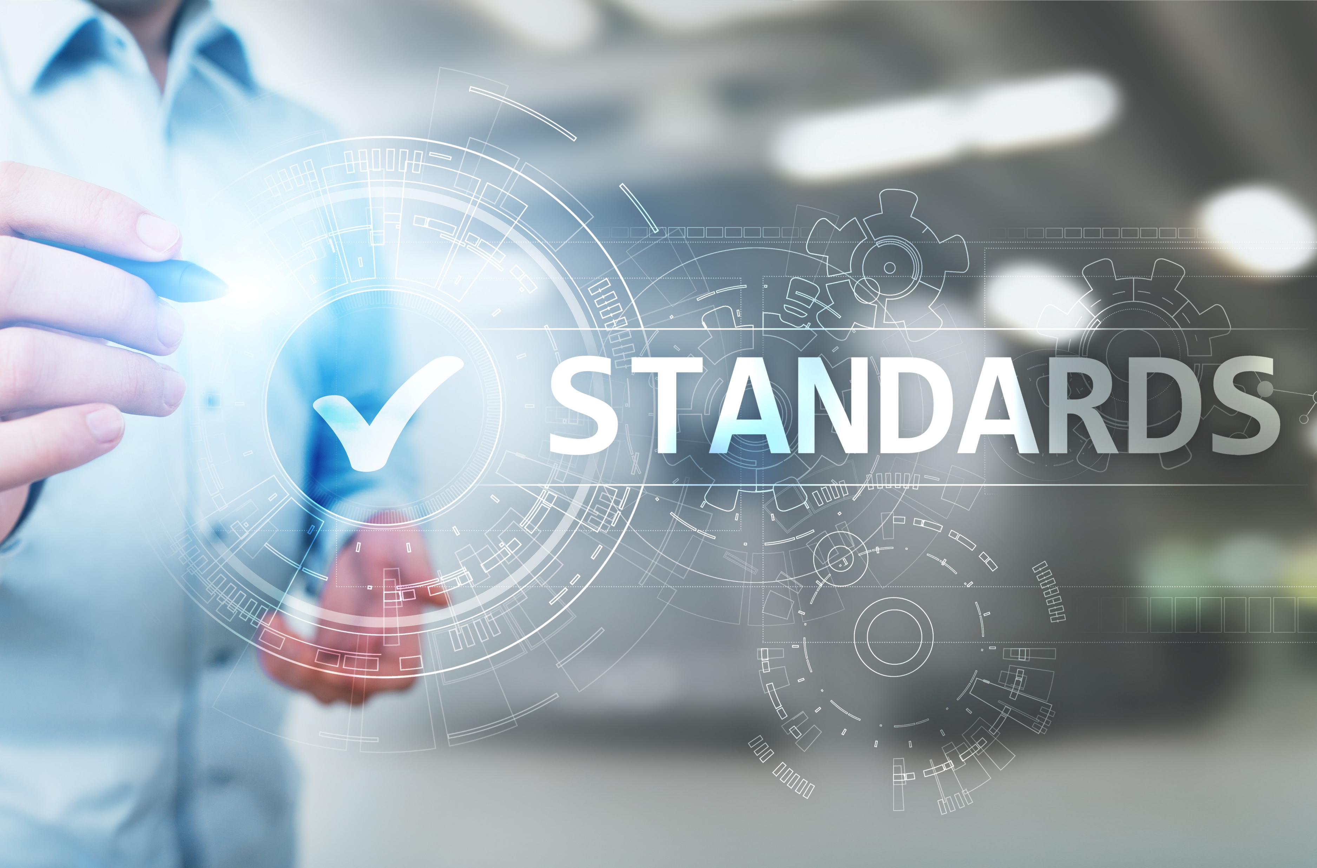
This discussion will focus on important information to prevent and control infections.
This information covers the following:
The description of the standard
The intention of the standard
The criteria of the standard
Identify the Role of Infection Prevention and Control in the Work Setting

Slide 14
Identifying standards and guidelines relevant to your role and work setting refers to looking for IPC standards and guidelines that fit your context.
Check the following to identify the IPC standards and guidelines that complement your situation:
Intended audience
Content
Identify the Role of Infection Prevention and Control in the Work Setting

Slide 15
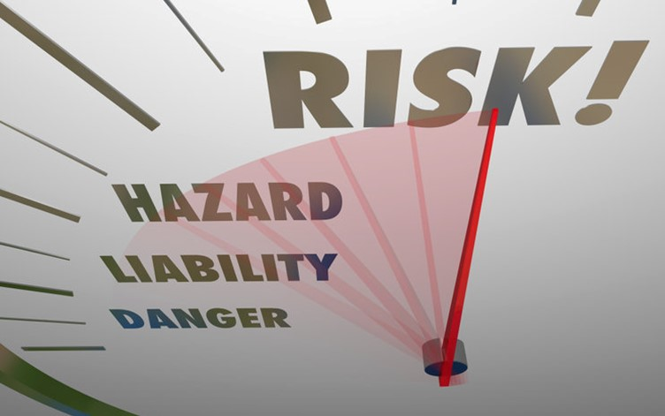
1.2 Identify Infection Risks and Hazards

Slide 16
Infection Hazards in the Workplace
Identify if any of the following potential hazards exist in your workplace:
Contaminated food
Contaminated water
Incidental exposure
Cuts from contaminated objects
Direct contact with an infectious substance
Contact of infectious substance with wounds and lesions
Identify the Role of Infection Prevention and Control in the Work Setting

Slide 17
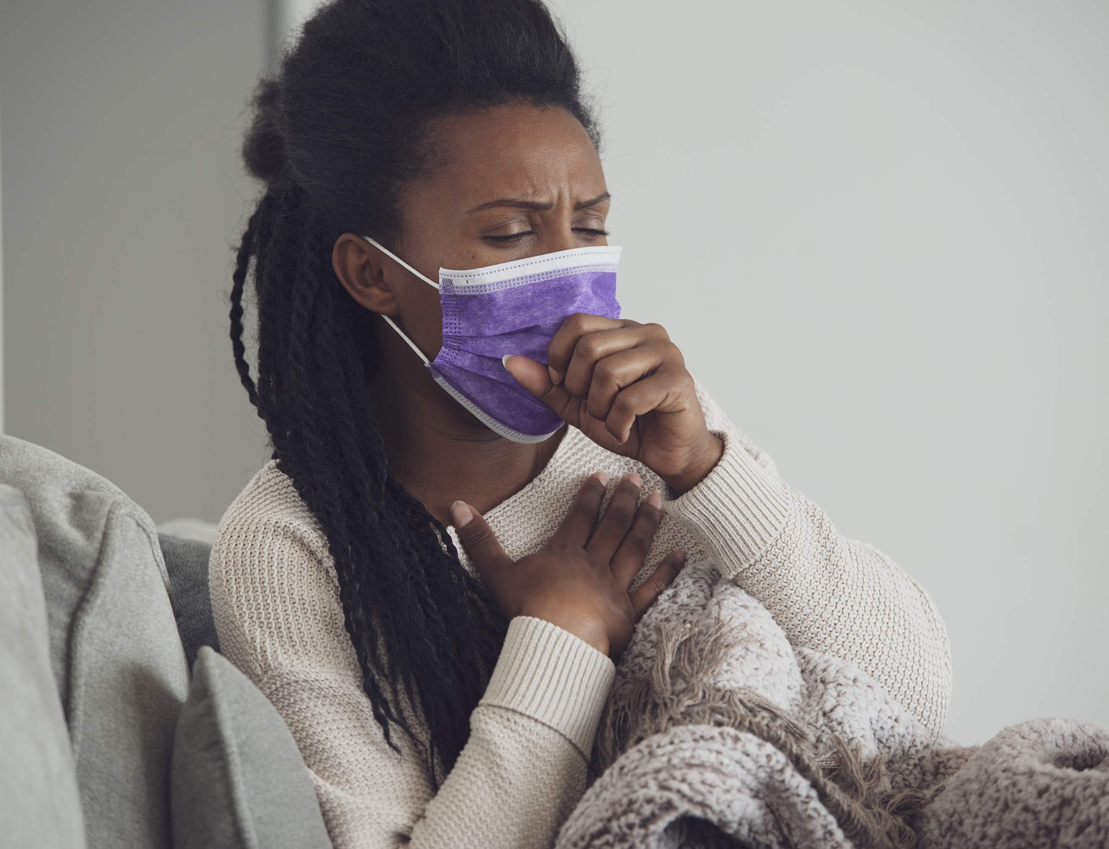
Infection Hazards in the Workplace
Identify if any of the following potential hazards exist in your workplace:
Poor ventilation
Workplace vector
Dry work area
Ill colleague
Identify the Role of Infection Prevention and Control in the Work Setting

Slide 18
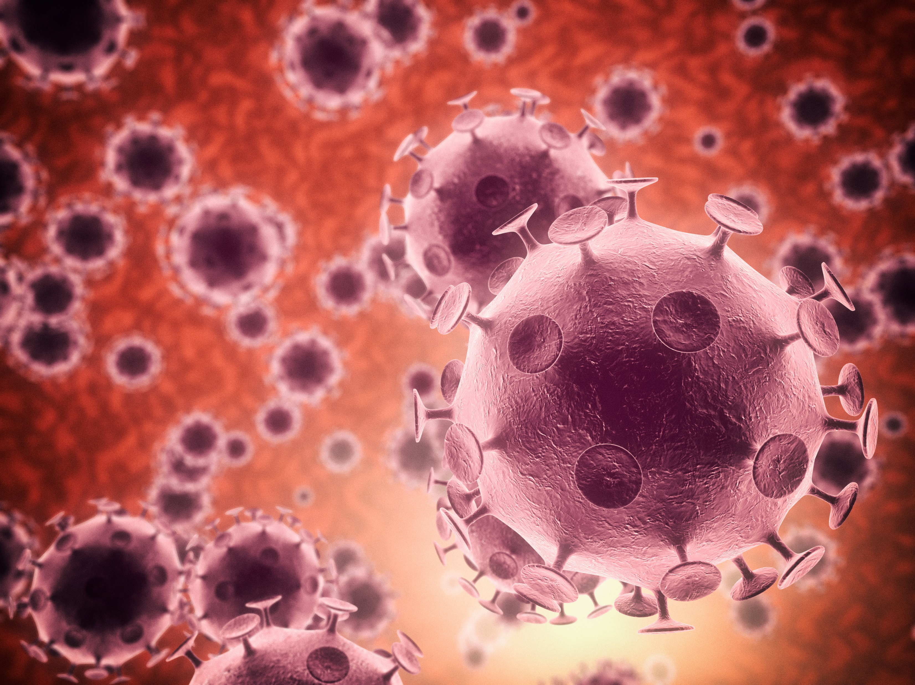
Infection Risks in the Workplace
Risks can come from the following hazards:
People
Surfaces
Air inside the workplace
Identify the Role of Infection Prevention and Control in the Work Setting

Slide 19
The chain of infection is a diagram that depicts how an illness spreads from the source to the host. Below is an example:
Causative agent
Means of transmission
Portal of entry
Susceptible host
Reservoir
Portal of exit
Identify the Role of Infection Prevention and Control in the Work Setting

Slide 20
1.2.1 Causative Agent
Pathogenic microorganisms differ from microorganisms in the following manner:
Non-pathogenic microorganisms – These are harmless microorganisms because they do not cause harm, disease or death to their host.
Pathogenic microorganisms or pathogens – These are microorganisms that can cause harm or disease in their host.
Identify the Role of Infection Prevention and Control in the Work Setting

Slide 21
Pathogens cause infection. This is why they are also referred to as causal agents.
Pathogens include the following:
Virus
Bacteria
Fungi
Parasite
Identify the Role of Infection Prevention and Control in the Work Setting

Slide 22
Degree of Pathogen Exposure
The amount to which a person encounters a pathogen determines the risk of infection or illness development.
Depending on various factors, pathogens can cause one of the following:
Colonisation
Infection
Disease
Exposure
Identify the Role of Infection Prevention and Control in the Work Setting

Slide 23
The probability of a person acquiring an infection if they are exposed to an infectious agent rises due to the factors below:
The infective dose of the pathogen
The amount of the infectious agent to infect the person
Below are workplace practices that can help lower the possibility of exposure:
Wearing personal protective equipment (PPE)
Cleaning and disinfecting high-touch areas and items regularly
Getting immunisation against infectious diseases
Identify the Role of Infection Prevention and Control in the Work Setting

Slide 24
1.2.2 Reservoir
Infection reservoirs are the environments in which infectious agents normally occur, flourish, and multiply. It might apply to organisms and/or the environment.
The following are examples:
People
Animals
Birds
Blood
Bodily fluids
Food
Water
Soil
Wastes
Identify the Role of Infection Prevention and Control in the Work Setting

Slide 25
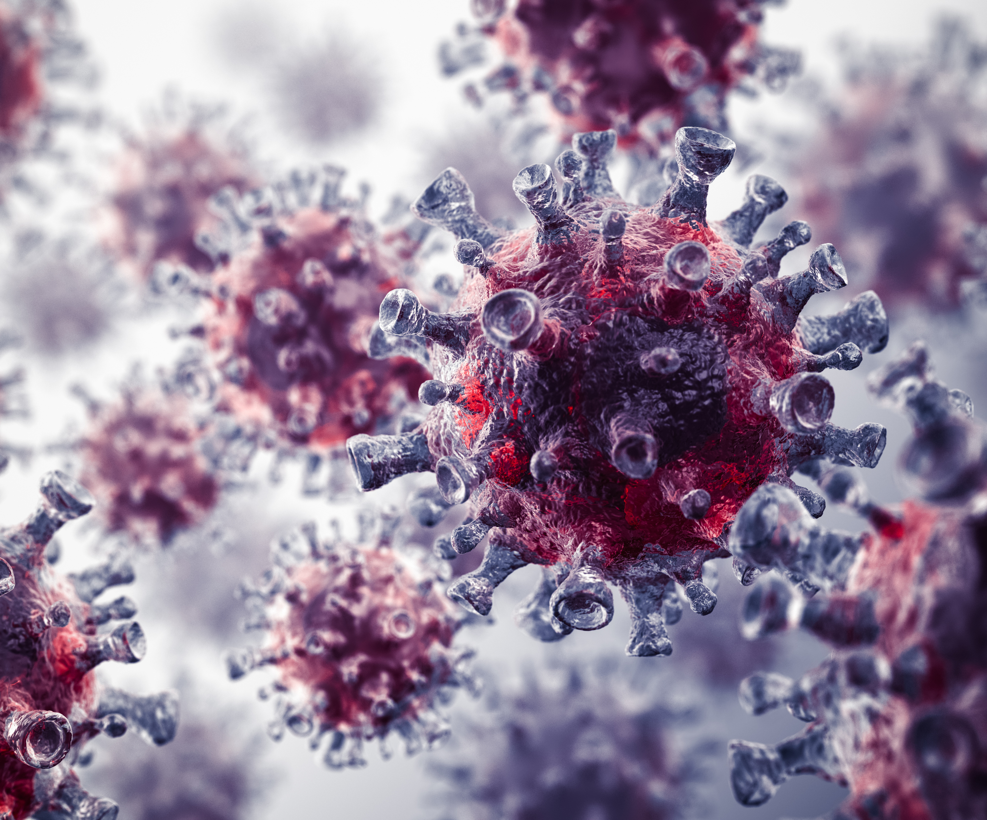
Human reservoirs are classified into two types:
Acute clinical cases – These are individuals that show signs of infection.
Carriers – These are individuals who carry pathogens but show no symptoms.
Identify the Role of Infection Prevention and Control in the Work Setting

Slide 26
1.2.3 Portal of Entry or Exit
Portals of Entry
The point where infectious agent exit or enter a host is referred to as a portal of entry or exit.
Pathogens can enter the body via the portals of entry shown below:
Respiratory tract
Mucous membrane
Gastrointestinal tract
Injury
Medical device insertion
Identify the Role of Infection Prevention and Control in the Work Setting

Slide 27
Portals of Exit
Pathogens can leave the body via the portals of exit shown below:
Fluid-filled blisters
Scab lesions on skin
Gastrointestinal tract (anus)
Identify the Role of Infection Prevention and Control in the Work Setting

Slide 28

1.2.4 Means of Transmission
The techniques or modes of transmission are referred to as the means of transmission, often known as routes.
These modes are divided into two types:
Direct contact transmission
Indirect contact transmission
Identify the Role of Infection Prevention and Control in the Work Setting

Slide 29
Below are the means of transmission:
Direct contact transmission
This happens when pathogens are passed through contact between an infected person and a susceptible person.
Indirect contact transmission
This happens when pathogens are passed without direct contact. They are instead passed through contaminated surfaces or objects, injuries and vectors.
Identify the Role of Infection Prevention and Control in the Work Setting

Slide 30
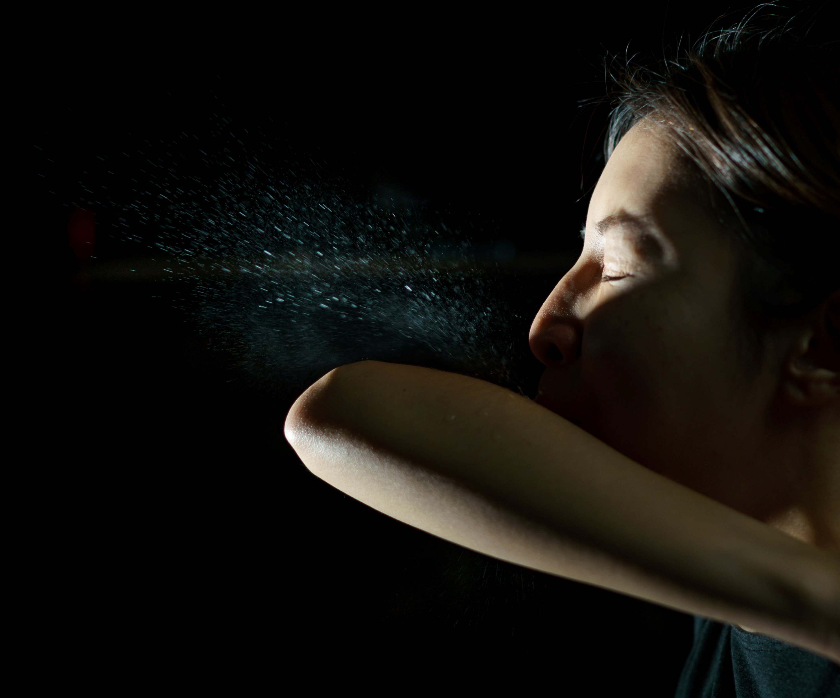
Direct Contact Transmission
This category is further subdivided into the following three modes of transmission:
Contact transmission
Droplet transmission
Airborne transmission
Identify the Role of Infection Prevention and Control in the Work Setting

Slide 31
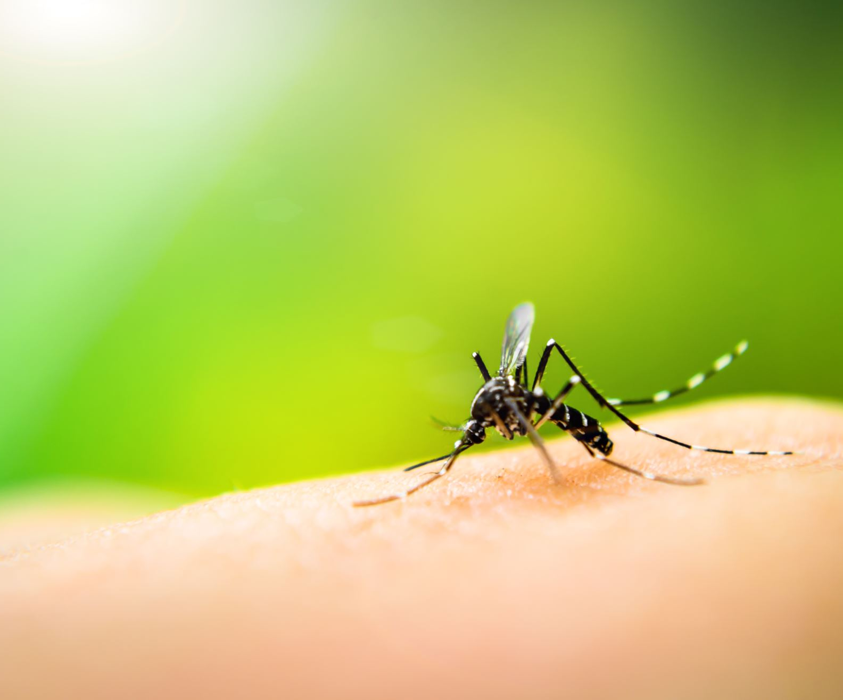
Indirect Contact Transmission
This category can also be subdivided into three types, such as the following:
Surface or object contamination
Penetrating injuries
Vectors
Identify the Role of Infection Prevention and Control in the Work Setting

Slide 32
1.2.5 Susceptible Host
A susceptible host is an individual at risk of becoming infected with an infectious agent.
Several variables boost a host's sensitivity, including the following:
Wounds
Immune status
Devices
Medications
Comorbidities
Age
Identify the Role of Infection Prevention and Control in the Work Setting

Slide 33
1.2.6 Identifying Infection Risks and Hazards
Now that you understand how the infection chain works, here are some pointers for determining infection risks and dangers in your job function and workplace:
Susceptible hosts need to be identified since they are at the most risk of getting infected
Locate high-contact surfaces in the work environment
Monitor how spilled liquids are disposed of in the workplace.
Look into how food and water are stored in the workplace.
Identify the Role of Infection Prevention and Control in the Work Setting

Slide 34

Below are some pointers for determining infection risks and dangers in your job function and workplace:
Check if your work role requires using sharps (devices like syringes and needles).
Check how the workplace deals with material and biological wastes
Identify the Role of Infection Prevention and Control in the Work Setting

Slide 35

1.3 Identify Roles and Responsibilities in Relation to Infection Prevention and Control

Slide 36
Infection prevention approaches are focused on reducing the risk of infections in the workplace. All healthcare workers must always observe these techniques.
The following are infection prevention approaches:
Proper hand hygiene that is consistent with the five moments for hand hygiene
Appropriate personal protective equipment
Safe use and disposal of sharps
Routine environmental cleaning
Identify the Role of Infection Prevention and Control in the Work Setting

Slide 37
The following are infection prevention approaches:
Proper reprocessing of reusable medical equipment and instruments
Respiratory hygiene and cough etiquette
Proper aseptic technique
Proper waste management
Appropriate handling of linen
Identify the Role of Infection Prevention and Control in the Work Setting

Slide 38
Infection control refers to the techniques that must be implemented in order to limit the risk of infection transmission in the workplace.
These tactics are known as transmission-based precautions.
Transmission-based precautions involve the following:
Application of transmission-based precautions
Contact precautions
Droplet precautions
Airborne precautions
Identify the Role of Infection Prevention and Control in the Work Setting

Slide 39
People's roles and responsibilities in the workplace typically adhere to the following pattern, regardless of industry:
People | Roles and Responsibilities
The person conducting business or undertaking | They are usually those who manage and oversee how work is run. Their responsibilities usually include planning and implementing risk management strategies. They are responsible for the health and safety of the entire workplace.
Identify the Role of Infection Prevention and Control in the Work Setting

Slide 40
People's roles and responsibilities in the workplace typically adhere to the following pattern, regardless of industry:
People | Roles and Responsibilities
Worker | These are the individuals who perform the work in a workplace. They are responsible for both their and others’ health. They must comply with workplace health and safety policies and procedures. Often, they will be asked to cooperate and collaborate in creating policies and procedures.
Identify the Role of Infection Prevention and Control in the Work Setting

Slide 41
People's roles and responsibilities in the workplace typically adhere to the following pattern, regardless of industry:
People | Roles and Responsibilities
Other persons at the workplace | They are the people who either visit or come from outside the organisation. They must comply with the workplace’s policies and procedures relating to health and safety, including but not limited to wearing PPE or staying away from restricted areas.
Identify the Role of Infection Prevention and Control in the Work Setting

Slide 42
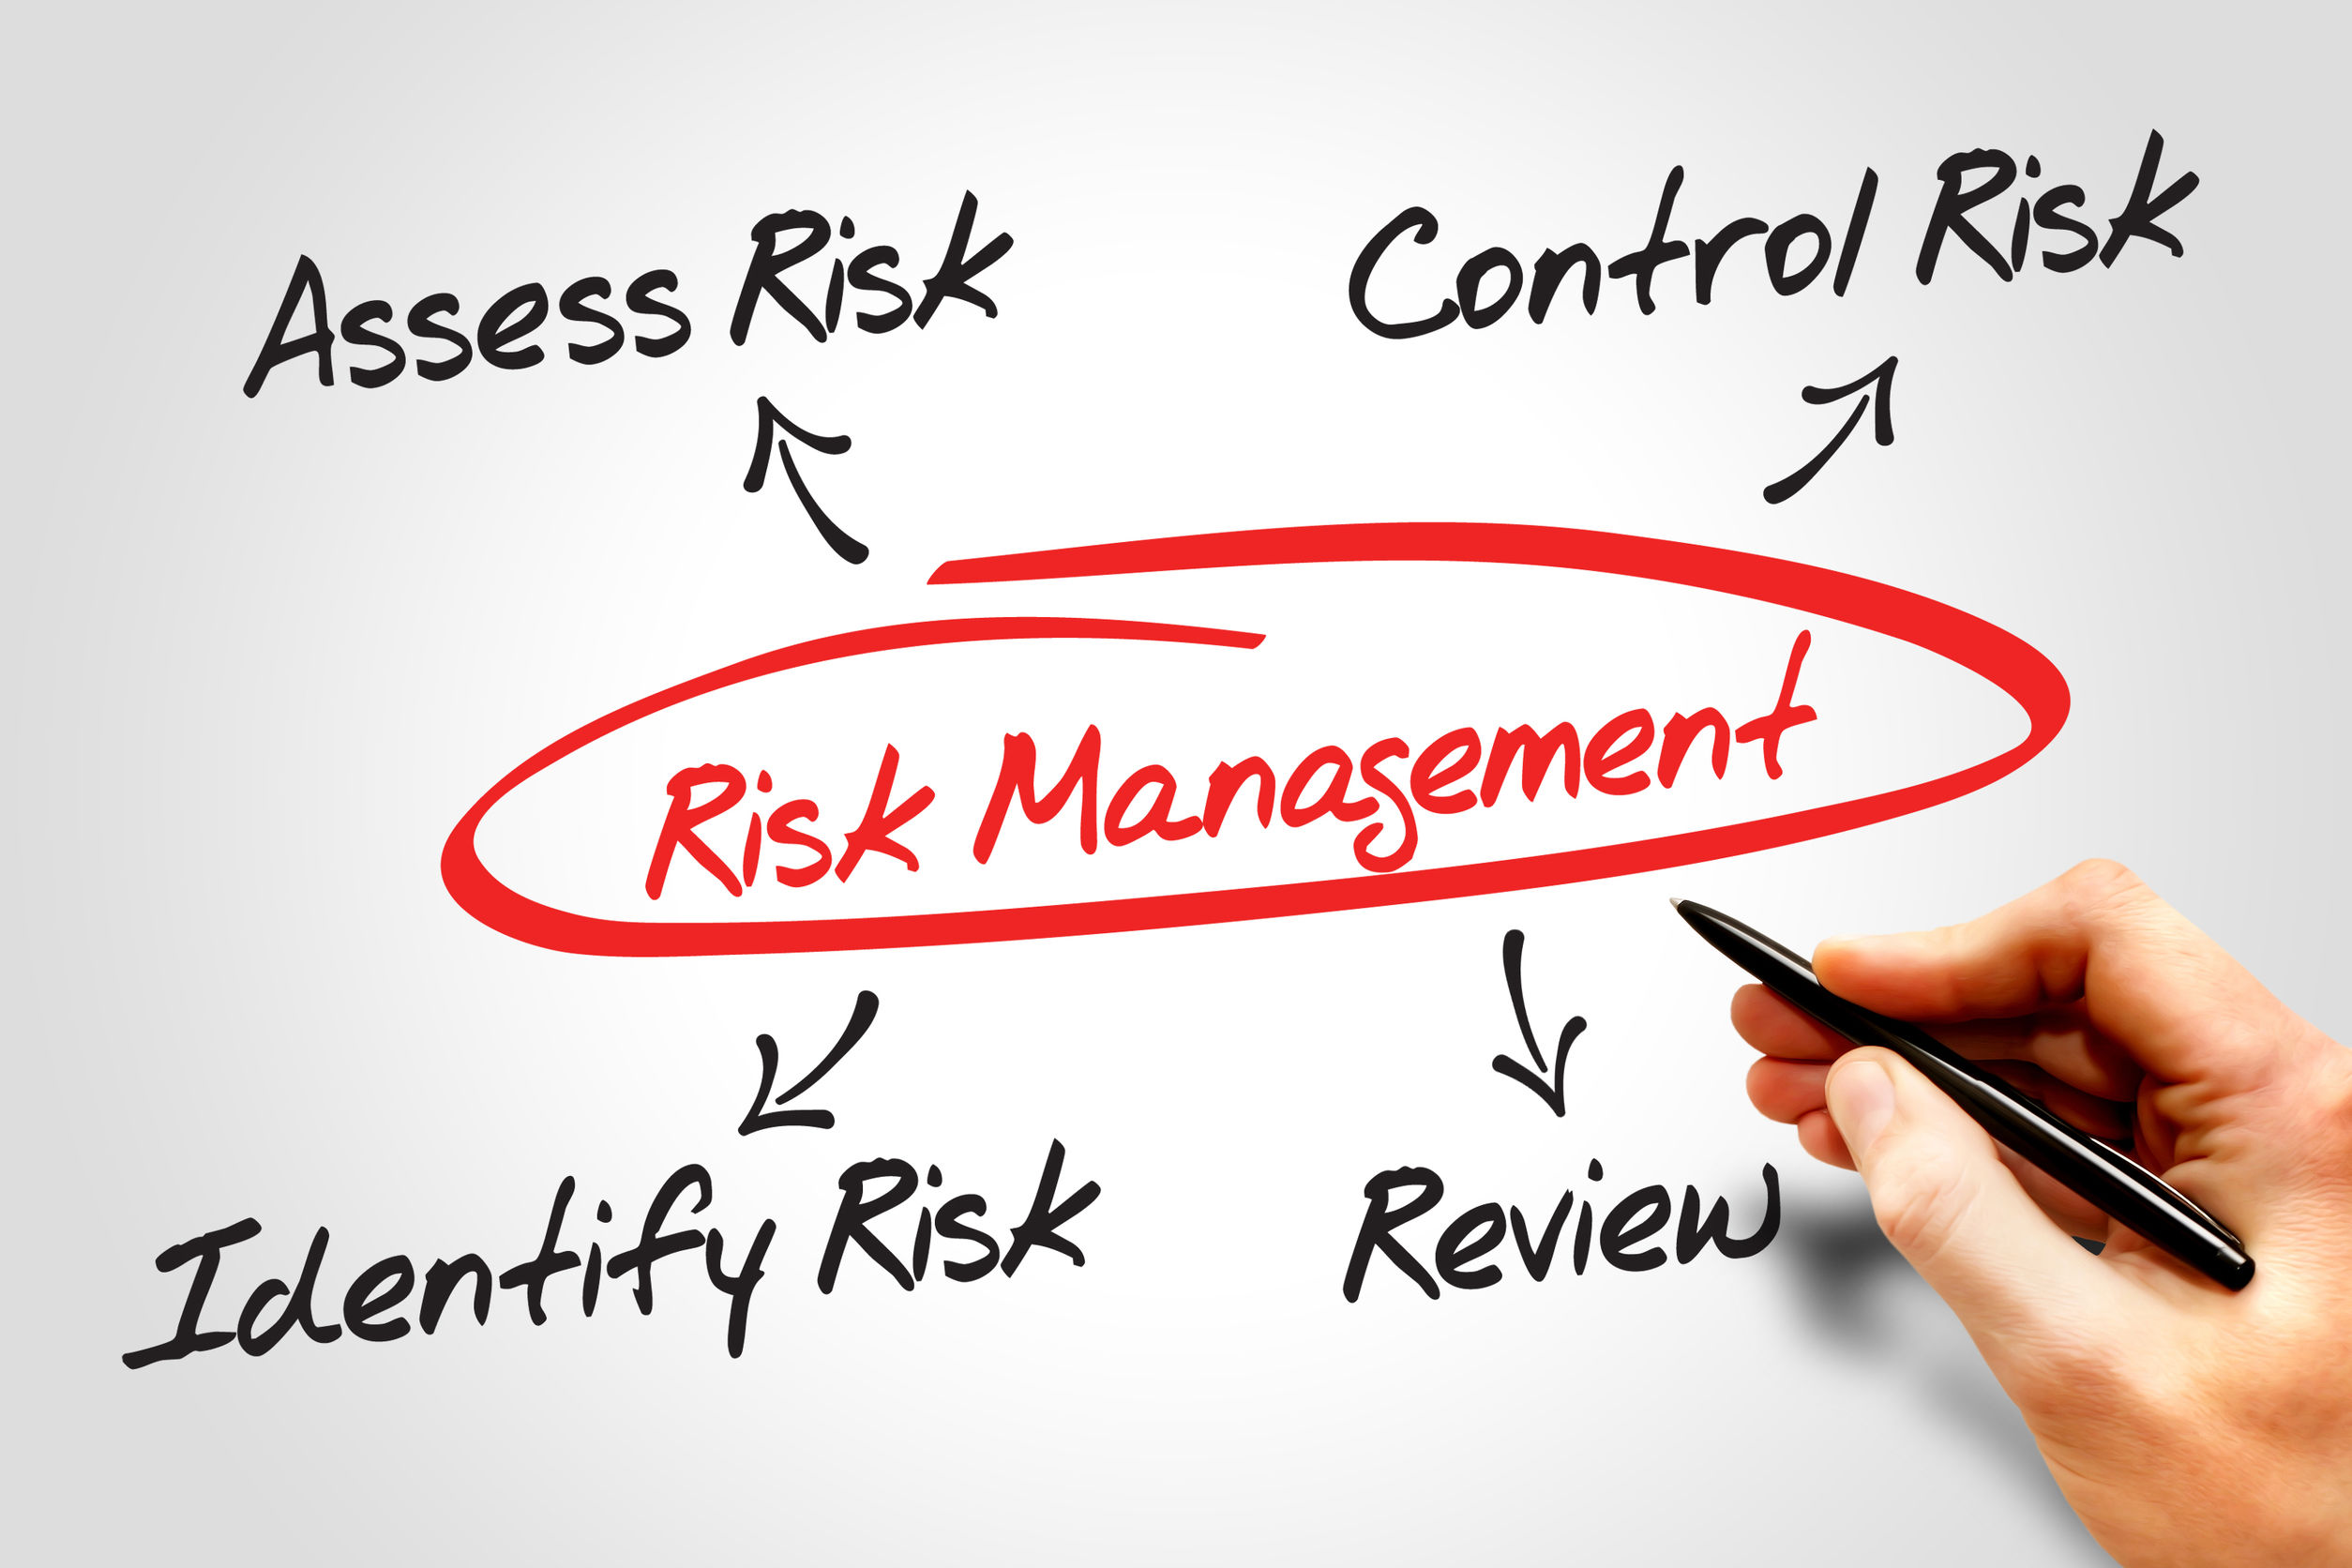
1.4 Identify Control Measures to Minimise Risk

Slide 43
Control measures are the methods you use to reduce risks.
To determine which control measures to apply, you must first identify how probable harm will occur or how severe the implications will be.
Risk is made up of two components:
Likelihood of occurrence
Severity of consequence
Identify the Role of Infection Prevention and Control in the Work Setting

Slide 44

1.4.1 Likelihood of Occurrence
The following questions are used to determine the likelihood of occurrence:
How frequently do you perform the task?
Does performing the task more often increase the chances of harm?
Has it happened before in similar or related situations?
Identify the Role of Infection Prevention and Control in the Work Setting

Slide 45
The table below shows an example of a measure of the likelihood of occurrence:
Likelihood
A (Almost certain) | This is expected to occur in most circumstances.
B (Likely) | This will probably occur in most circumstances.
C (Possible) | This could occur at some time.
D (Unlikely) | This is not likely to occur in normal circumstances.
E (Rare) | This may occur only in exceptional circumstances.
Identify the Role of Infection Prevention and Control in the Work Setting

Slide 46
1.4.2 Severity of Consequence
Consider the following questions when determining the degree of the consequence:
What kind of harm could occur? What is the severity of the hazard's impact?
What factors might influence the severity of the potential harm?
Identify the Role of Infection Prevention and Control in the Work Setting

Slide 47
Here are some examples of severity classifications:
Consequence
1 (Insignificant) | Minor injuries, external reputation not affected, no environmental damage and the threat of litigation
2 (Minor) | Minor casualties that require medical attention off-site, no long-term effects, external reputation minimally affected, minor environmental damage, and single minor litigation
Identify the Role of Infection Prevention and Control in the Work Setting

Slide 48
Here are some examples of severity classifications:
Consequence
3 (Moderate) | Several casualties that require hospitalisation with no long-term effects, some environmental damage, and single moderate litigation
4 (Major) | Serious casualties, external reputation severely damaged, would cause extensive environmental damage, and single major litigation
5 (Severe) | Legal consequences, termination of the contract, loss of life, permanent disability, external reputation irrevocably damaged, and catastrophic environmental damage
Identify the Role of Infection Prevention and Control in the Work Setting

Slide 49
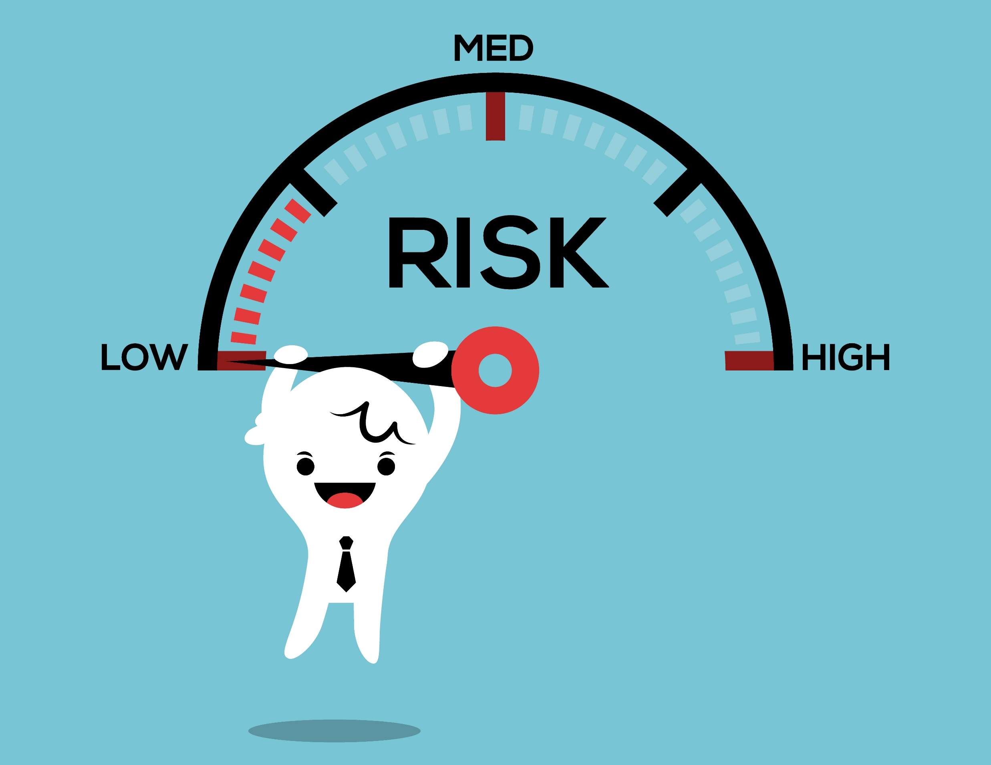
1.4.3 Risk Analysis Matrix
A risk analysis matrix is a technique used to depict risk classification by combining the likelihood of occurrence and severity of consequence.
It enables you to determine whether hazards require action and what mitigation actions are necessary for a particular scenario.
Identify the Role of Infection Prevention and Control in the Work Setting

Slide 50
A risk analysis matrix is shown in the table below:
Likelihood | Consequence
 | Insignificant | Minor | Moderate | Major | Severe
 | 1 | 2 | 3 | 4 | 5
A (Almost certain) | Moderate | High | High | Very High | Very High
B (Likely) | Moderate | Moderate | High | High | Very High
C (Possible) | Low | Moderate | Moderate | High | High
Identify the Role of Infection Prevention and Control in the Work Setting

Slide 51
A risk analysis matrix is shown in the table below:
Likelihood | Consequence
 | Insignificant | Minor | Moderate | Major | Severe
 | 1 | 2 | 3 | 4 | 5
D (Unlikely) | Low | Low | Moderate | Moderate | High
E (Rare) | Low | Low | Low | Moderate | Moderate
Identify the Role of Infection Prevention and Control in the Work Setting

Slide 52
Different risk classifications need various responses:
Situations classified as low risk are managed by routine procedures.
Situations classified as moderate risk are managed by specific monitoring or audit procedures.
Situations classified as high-risk are serious and must be addressed immediately.
Situations classified as very high risk call for a specific response according to the context and effectiveness of your healthcare facility's existing strategies and controls.
Identify the Role of Infection Prevention and Control in the Work Setting

Slide 53
1.4.4 Identifying Control Measures
Hierarchy of Control
The most effective control measure sits at the top. Below is the hierarchy of control:
Elimination
Substitution, isolation or engineering control
Administrative control
PPE
Identify the Role of Infection Prevention and Control in the Work Setting

Slide 54

National Standards and Guidelines
National standards and guidelines are regulations developed by the Australian industry and professionals to ensure the quality of processes and products.
Below are examples:
Work Health and Safety Legislation
Australian Guidelines for the Prevention and Control of Infection in Healthcare
Identify the Role of Infection Prevention and Control in the Work Setting

Slide 55
Identifying Control Measures
Identifying control measures entails deciding the control measure to use in response to a hazard.
These are the ways to identify hazard control measures:
Review the task, work site, and the associated hazards.
Come up with measures that correspond to the hierarchy of control.
Pick a preferred control option.
Identify the Role of Infection Prevention and Control in the Work Setting

Slide 56

1.5 Communicate Information Relevant to Risk Management

Slide 57
The following is a step-by-step approach to risk management:
Establish the context
Avoid risks
Identify risks
Analyse risks
Evaluate risks
Identify the Role of Infection Prevention and Control in the Work Setting

Slide 58

Types of Information to Communicate
You may need to communicate the following categories of information:
Reports
Instructions
Identify the Role of Infection Prevention and Control in the Work Setting

Slide 59

People with whom you will communicate involve the following:
Supervisor
General practitioner
Health care professional
Carer
Responsible person
Responsible authority
Identify the Role of Infection Prevention and Control in the Work Setting

Slide 60
Policies and Procedures
The following Lotus Compassionate Care Services policies and procedures can be used as a reference for communicating with other personnel:
You should take immediate action to remove or minimise the risk associated with any hazards.
You must notify your supervisor immediately if you cannot control the hazard.
You must document all hazards identified or reported by clients, visitors and/or family members which they cannot eliminate immediately.
Identify the Role of Infection Prevention and Control in the Work Setting

Slide 61
The following Lotus Compassionate Care Services policies and procedures can be used as a reference for communicating with other personnel:
All hazards must be documented on the Hazard Report Form.
The Hazard Report Form must be completed and forwarded to the supervisor within the prescribed timeframe.
Identify the Role of Infection Prevention and Control in the Work Setting

Slide 62

Communicating With Others
To communicate efficiently with others about infection risk management, here are a few tips:
Listen attentively.
Speak clearly.
Ask effective questions.
Identify the Role of Infection Prevention and Control in the Work Setting

Slide 63

1.6 Document Risks and Risk Management Strategies

Slide 64

Recording Identified Infection Risks
Here are some ideas for recording detected infection risks:
Check if existing documents have taken note of the infection risk before.
Use the appropriate form when updating or starting a record of identified risks.
Make sure that all information recorded is accurate and complete.
Identify the Role of Infection Prevention and Control in the Work Setting

Slide 65
Be knowledgeable about your organisation's risk-recording policies and procedures.
Consider the following details:
The appropriate department in your organisation that you must notify about the risks
The timeframe by which the report must be submitted
The appropriate hazard and risk identification report form that you must fill out
The information that must be included in your report
The appropriate person to whom you must submit the report to
Identify the Role of Infection Prevention and Control in the Work Setting

Slide 66
Hazard and Risk Identification Forms
When reporting hazards:
Report the hazard to your direct supervisor.
Fill out a Hazard Report form, Hazard Identification form, or hazard register.
Provide details about the hazard, including the following:
The location of the hazard
The description of the hazard
Identify the Role of Infection Prevention and Control in the Work Setting

Slide 67

Recording Risk Management Strategies
Risk management strategies are the methods implemented to address the identified risks.
They include the following:
Strengthening staff education
Establishing a reporting system
Promoting transparency
Enhancing communication
Identify the Role of Infection Prevention and Control in the Work Setting

Slide 68
Risk management strategies and details must be recorded in a risk register document.
The risk registry aims to provide answers to the following questions:
What are the identified infection hazards?
What is the harm that the hazard could cause?
What is the likelihood that harm would occur?
How effective are the current control measures?
What are further control measures required?
Identify the Role of Infection Prevention and Control in the Work Setting

Slide 69
Keeping track of the risk management process helps to:
Provide an example of how decision-making relevant to risk control is done
Assist in targeting training at key hazards
Provide a reference for safe work procedures in the workplace
Ease the reviewing of risks to keep up with changes in relevant laws
Provide evidence to other stakeholders that WHS risks are being managed in the workplace
Identify the Role of Infection Prevention and Control in the Work Setting

Slide 70

What have we learnt?
In this part of the session, we have covered:
Identify the role of infection prevention and control in the work setting
Follow standard and transmission-based precautions for infection prevention and control in the work setting
Respond to potential and actual exposure to infection risks within scope of own role

Slide 71
End of Chapter 1

